Slide 1
MASTER OVERVIEW · PRIVATE
ANTEdge — The Full Journey,
One Deck
From a blind survey of 377 investors to a five-module platform, its system design and performance work, and how every piece of it was tested. A short overview; each companion deck goes deeper module by module.
Prepared by Vignesh Swamynathan

Slide 2
2
How this is organized
FOUR PHASES, TWO SLIDES EACH
This deck moves through the whole project at a general level: why it was built, what was built, how it was made fast and reliable, and how it was proven to work. Anyone short on time can stop here; anyone who wants the full detail behind any phase can open the matching companion deck.
1
Product Research — why these five modules, not any others
2
Product Build — what the five modules actually do
3
System Design & Optimization — the architecture and the performance work on top of it
4
Testing — how every piece of it was checked before being trusted
ANTEdge — Master Overview

Slide 3
3
Product Research — the evidence first
PHASE 1 OF 4 · 1 OF 2 · BEFORE ANY PRODUCT DECISION
Four academic findings on why unaided investors underperform came first, then a 10-question blind survey, no product or feature mentioned, sent to self-directed investors. 377 responded.
89.7%
86.7%
75.6%
64.0%
don't systematically adjust for market conditions
report real friction evaluating a company
research each pick case by case, not by rule
have no rule for what to do when a position falls
The problem: self-directed investors are trying to manage their own money with real discipline, but lack systematic, tested methods for stock selection, position sizing, risk response, market condition awareness, company valuation, and separating a genuinely robust idea from a lucky-looking one.
377 respondents · 10 questions · 8 competitors checked afterward, none covered all five domains
ANTEdge — Master Overview

Slide 4
4
Product Research — five modules, five answers
PHASE 1 OF 4 · 2 OF 2 · WHY THESE FIVE, NOT ANY OTHERS
Macro Regime (AI/ML)
1
Answers the 89.7% who don't read the market environment systematically; no checked competitor names a specific regime or timing signal, AI-based or otherwise
Factor Strategy
2
Answers the 75.6% who pick stocks case by case; broad tools show scores, not a disclosed, repeatable method
Portfolio & Risk Management
3
Answers the 64.0% / 54.4% with no rule for loss response or real diversification, tying sizing to actual correlation
Long Term Valuation
4
Answers the 86.7% who report real friction evaluating a company; deep tools exist but assume a finance background
Short Horizon Trading
5
Answers the 67.7% who want robustness evidence, not a headline return; no checked tool discloses that kind of check
ANTEdge — Master Overview

Slide 5
5
Product Build — the five modules
PHASE 2 OF 4 · 1 OF 2 · WHAT EACH ONE ACTUALLY DOES
Factor Strategy
Portfolio & Risk
Management
Macro Regime
(AI/ML)
Long Term
Valuation
Short Horizon
Trading
Seven factor lenses; five tested against six market regimes, not just averaged. Pick ratios, build a shortlist, backtest against SPY since 2009.
Three basket diagnostics (volatility, correlation, return-quality spread), then five allocation methods: equal, inverse-vol, optimizer, HRP, regime-adaptive.
An AI/machine-learning model (a Gaussian Hidden Markov Model) classifies the market into one of six regimes live, from thirteen real signals across stocks, bonds, and credit. Overlays on every other module.
Independent five-step estimate of what a business is worth: ROIC, WACC, Forecast, DCF, Comps, each flagging what data was missing or estimated.
Ten mechanical trading rules tested on real prices, checked against six regimes to see when they actually work, not just whether.
Turns case-by-case picking into one repeatable, tested process.
Turns basket risk into a chosen allocation, not a default.
The one signal every other module can lean on.
Separates price from what the business is actually worth.
Proof an edge holds up, not just a good-looking backtest.
AT A GLANCE
AT A GLANCE
AT A GLANCE
AT A GLANCE
AT A GLANCE
7 factor lenses
5 allocation methods
AI/ML model, live
5-step process
10 strategies
5 of 7 regime-tested
3 basket diagnostics
6 regimes, 13 signals
ROIC → WACC → DCF
Tested across 6 regimes
ANTEdge — Master Overview

Slide 6
6
Product Build — how it was learned to build well
PHASE 2 OF 4 · 2 OF 2 · SCOPE FIRST, COURSEWORK AFTER
Every module started as a product decision made first, from the research in Phase 1. The coursework and certifications below were taken afterward, specifically to learn how to build that decision well, not the other way around.
Factor Strategy
1
Quant investing & feature engineering for trading, plus a Georgetown regression course for combining multiple ratios into one ranking
Portfolio & Risk Management
2
Hierarchical Risk Parity and quantitative portfolio management courses, plus Georgetown Corporate Finance for cost of capital and CAPM
Macro Regime (AI/ML)
3
The nearest formal course stopped at basic clustering; the AI/machine-learning model actually used, a Hidden Markov Model, was learned independently, starting on YouTube
Long Term Valuation
4
Georgetown's Valuation, Corporate Finance, Financial Modeling, and Applied Value Investing courses, each mapped to one step of the five
Short Horizon Trading
5
One course per strategy category needed: algorithmic, day trading, event driven, and volatility, plus a shared backtesting-engine course
Two courses sit underneath all five: Linear Algebra & Calculus, and Georgetown Managerial Statistics.
ANTEdge — Master Overview

Slide 7
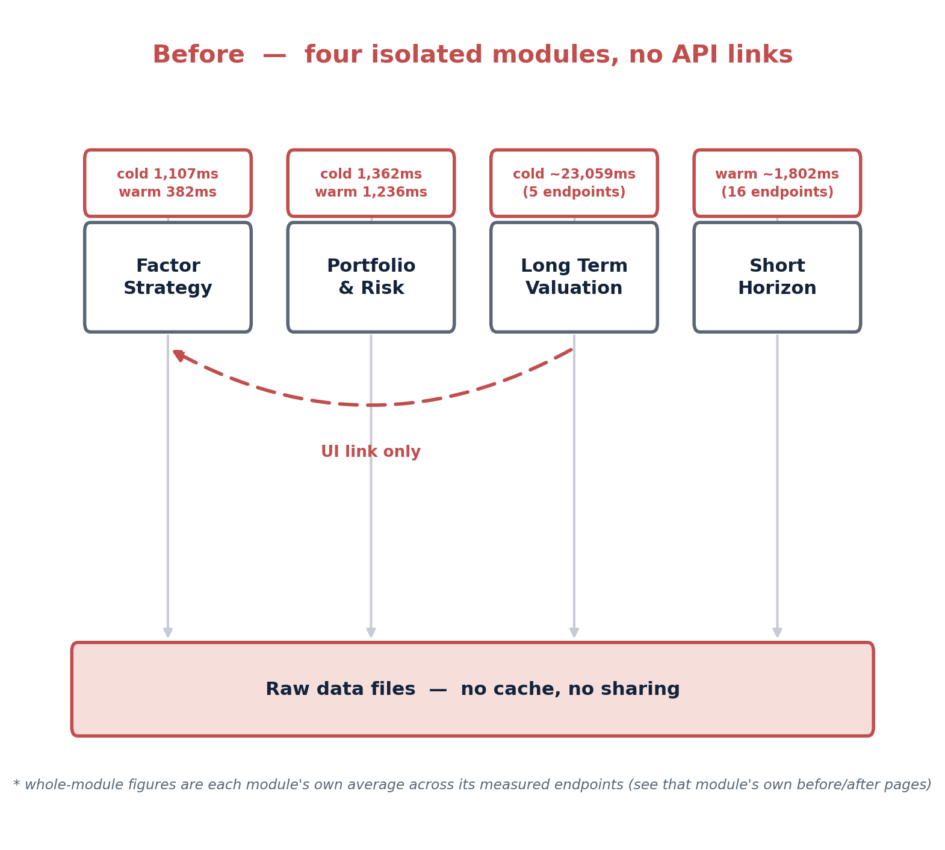
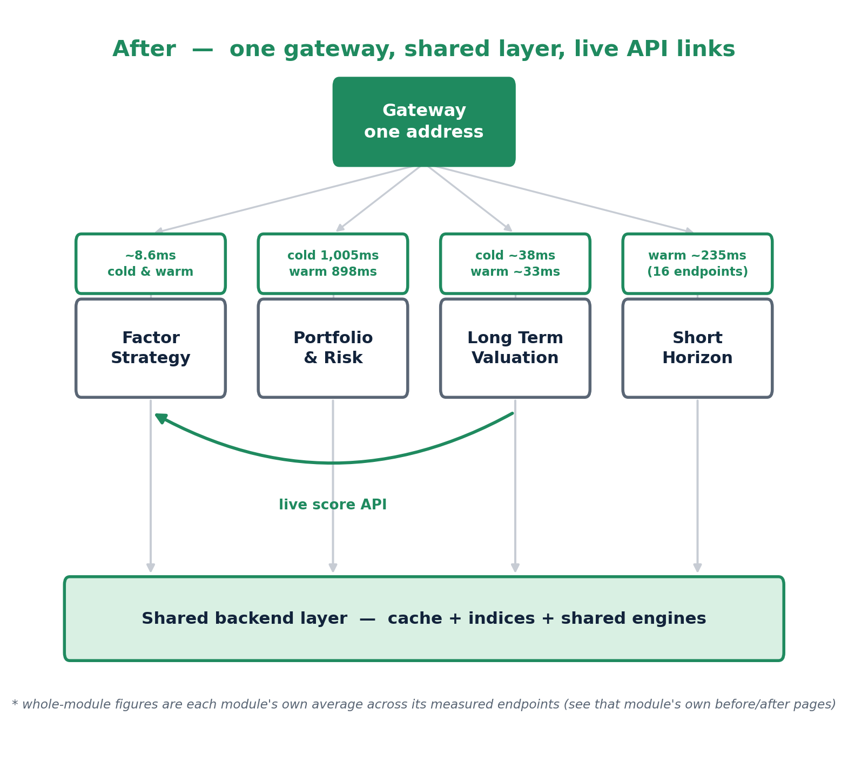
7
System Design — from five islands to one platform
PHASE 3 OF 4 · 1 OF 2 · ARCHITECTURE, BEFORE AND AFTER
BEFORE · five isolated modules, no shared layer
AFTER · one gateway, shared layer, live links
Fourteen separately-started servers with no shared cache or link between them became one gateway in front of all five modules, a shared backend layer, and live AI/ML regime and scoring APIs in place of stale local copies and UI-only links.
ANTEdge — Master Overview

Slide 8
8
System Design — four modules, measured end to end
PHASE 3 OF 4 · 2 OF 2 · BUILT ON TOP OF THE SHARED LAYER
Module | Before | After | Stages of change
Factor Strategy | 1,107ms cold avg | ~8.6ms cold & warm | 6: instant lookup, parse once, vectorize, cache fixed history, persist the index, warm everything
Portfolio Management | 1,362ms cold avg 1,236ms warm avg | 1,005ms cold avg 898ms warm avg | 4: warm at startup, parse once, reuse the cluster tree (trade-off disclosed), give the optimizer the exact gradient
Short Horizon Trading | ~1,802ms warm avg | ~235ms warm avg | 4: zero-copy index, vectorize the trade sheet, parse once, warm everything
Long Term Valuation | ~23,059ms cold avg | ~38ms cold avg | 4: collapse a full scan to a snapshot, chase down a second hidden file, fix “warmed” vs “loaded”, zero-copy index & warm everything
The single biggest win: Long Term Valuation's comps page, 28,973ms → 31.31ms cold (about 925x). The one deliberate trade-off — Portfolio Management's HRP cluster reuse — was measured and disclosed, not hidden.
ANTEdge — Master Overview

Slide 9
9
Testing — module by module, then across all of them
PHASE 4 OF 4 · 1 OF 2 · UNIT TESTING, THEN INTEGRATION TESTING
Every module was checked in isolation first, then checked again against every other module it now actually calls — real bugs caught both times, not just theoretical risk.
UNIT TESTING · MODULE BY MODULE
INTEGRATION TESTING · ACROSS MODULES
1
HMM Macro Regime
Three modules, one stale regime
An 18-day “Systemic Crisis” streak was actually an unadjusted stock split, not a real crisis — rebuilt from a clean source.
1
2
Factor Strategy — short legs
Each kept its own local copy of the market regime; a reproduced cold-start outage caught a real disagreement live. All three rewired to one live source, confirmed to agree after.
A short position was never actually short, no sign flip existed — found in Skewness, confirmed in Momentum too.
3
Factor Strategy — annualized return
Six broken links a live boot test found
The shared formula averaged instead of compounding — fixed platform-wide, all 129 tests re-verified.
2
4
Portfolio Management
The gateway's rewrite rules were logic-tested but never booted live — walking all 14 routed sections found six broken links a code read alone missed, all fixed and re-verified hop by hop.
The real worst-ever drawdown was mislabeled by 38 points, a dollar-vs-percent bug shared by all five methods.
5
Short Horizon Trading
A dividend mismatch, caught on the first loader
The SPY+VIXY hedge was quietly 1.5x levered, never divided by the real capital deployed.
3
6
Long Term Valuation
Migrating SPY's price source silently dropped dividend adjustment; caught before it could propagate into any of the six real downstream consumers.
36.5% of the ticker universe had no usable ratio table — standardized fallbacks built for all 2,034 tickers.
9 headline bugs like these (6 unit, 3 integration), plus 19 more found and fixed along the way — the full list lives in Testing_Unit_and_Integration.pdf.
ANTEdge — Master Overview

Slide 10
10
Testing — real numbers behind the two passes
PHASE 4 OF 4 · 2 OF 2 · WHAT IT ACTUALLY CAUGHT
28
36.5%
6 / 6
1.5x
real bugs found and fixed — 6 unit-test headlines, 3 integration-test headlines, 19 more logged
of the ticker universe, 742 of 2,034, had no usable ratio table before Long Term Valuation's fix
broken gateway links found by an actual live boot test, not a code read alone
a hedge strategy was quietly levered by, undetected until it was actually checked
Nothing here was assumed correct in advance. Every one of these bugs, from an unadjusted stock split mislabeled as a market crisis to a hedge quietly levered 1.5x, was traced to its real root cause and reproduced directly, not patched blind and hoped-fixed.
That same discipline, real behavior checked before a fix, real output verified after, real trade-offs disclosed, is what makes every number in this deck one that can be trusted rather than just asserted.
ANTEdge — Master Overview

Slide 11
11
The Timeline — How This Came Together
FROM DOMAIN KNOWLEDGE TO BETA, STAGE BY STAGE
One continuous path: the coursework and domain knowledge that came first, then the build, then the system design and optimization pass, then testing and documentation — and what comes next.
1
2
3
4
5
SEP 2024 – JAN 2026
FEB – MAY 2026
JUN – JUL 2026
AUG – SEP 2026
NEXT
Gaining Domain Knowledge
Built the Product
System Design & Optimization
Testing & Documentation
Beta Testing
MBA, Georgetown University
Investment coursework
Machine learning, independent study
Designed and built all five modules, from the ground up.
Rebuilt the architecture and optimized performance platform-wide.
Unit and integration testing, plus the full Thought Process write-ups.
Opening the product up for real user feedback.
Sixteen months building the foundation, four months building the product, two months on system design, two more on testing and documentation — and beta testing next.
ANTEdge — Master Overview

Slide 12
One platform, five modules, four phases of real work
If you want to go deeper on any phase, each one has its own full deck:
Product_Story_Research_Survey_Competitive_Analysis
The research, the survey, the competitive check, and the case for five modules
Product_Walkthrough_Non_Technical / Technical
Each of the five modules, in plain language and in build detail
Architecture_and_Optimization
The architecture evolution and every performance win, module by module, in full
Testing_Unit_and_Integration
Every real bug caught testing each module alone, then testing them together — nine headline stories, told in full
HMM_Macro_Regime_Deep_Dive
The AI/ML-based Macro Regime model's full story, from motivation to six states, live
Error_Correction
The six headline bugs found and fixed, traced to their real root cause
This deck is the short version. Every companion deck above is the long one.
ANTEdge — Master Overview

