Slide 1
PRODUCT WALKTHROUGH · PRIVATE
Product Walkthrough
What each module actually gives you, feature by feature, in real screenshots from the live product. Written for a general, non-technical reader.
Prepared by Vignesh Swamynathan

Slide 2
2
The five modules
WHAT EACH MODULE ANSWERS
Factor Strategy
1
Eight lenses on what actually predicts returns, each one testable, not just readable.
Portfolio & Risk Management
2
Picking good stocks is only half the decision. Three real diagnostics, then five ways to size each position.
Long Term Valuation
3
Price is what the market says. Value is what the business earns above what it costs to run.
Short Horizon Trading
4
Not what a business is worth — what the price is about to do next, and whether that edge actually held up.
Macro Regime
5
The question underneath all four other modules: what kind of market is this, right now?
Five modules, five different questions an investor actually has — which traits predict returns, how much to put into each stock, what a business is really worth, what a price is about to do next, and what kind of market this actually is right now.
Product Walkthrough · Non-Technical

Slide 3
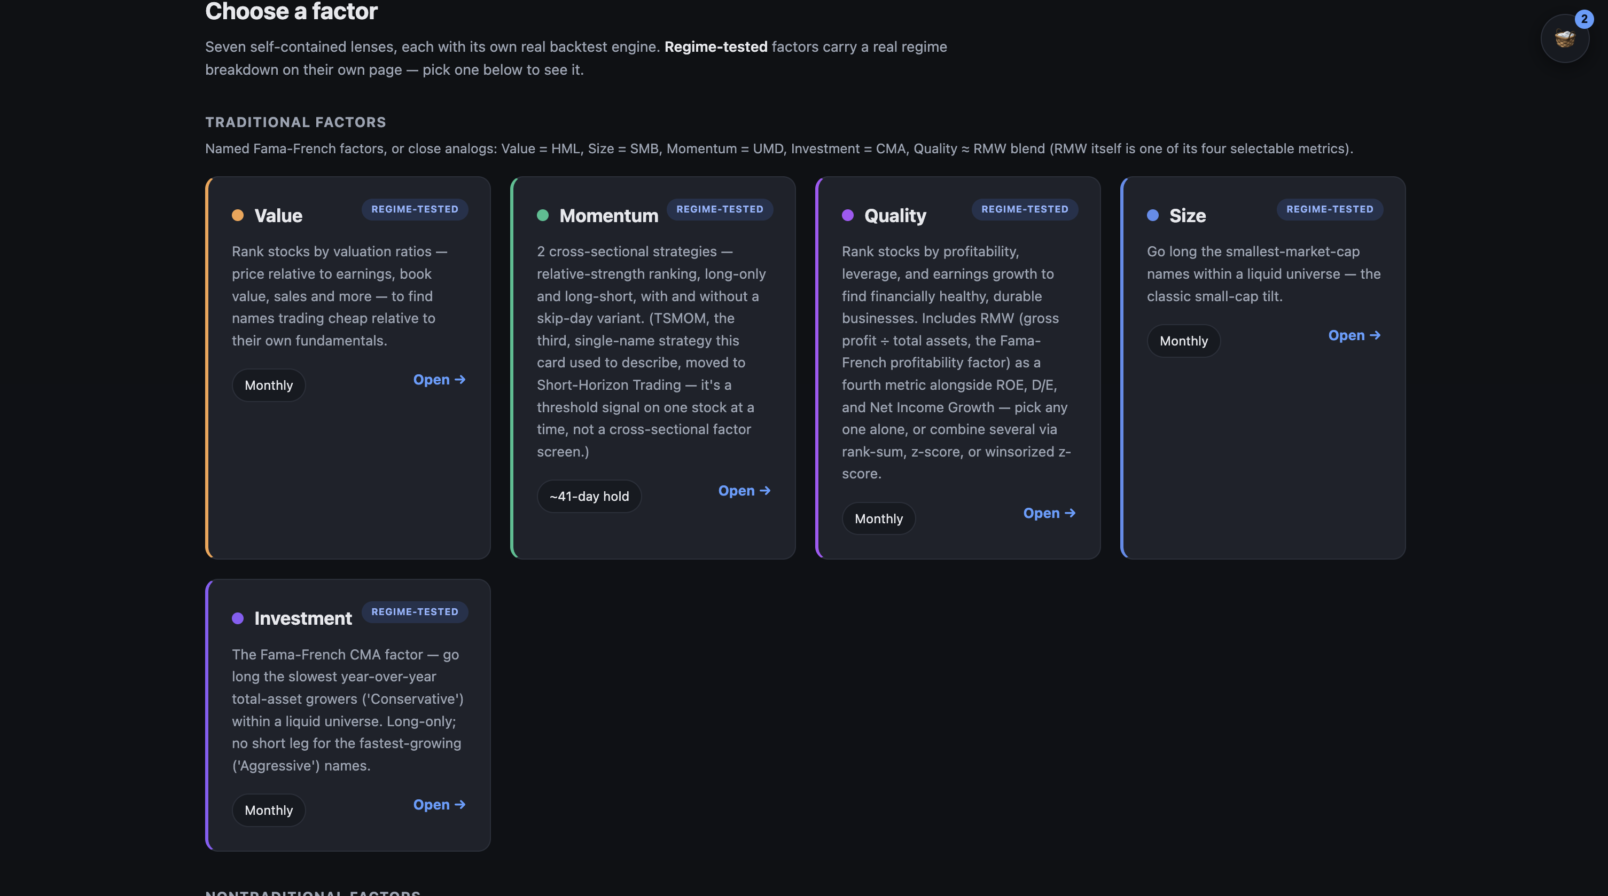
3
Factor Strategy
MODULE 1
Factors are specific, measurable traits in a stock's own numbers — being cheap relative to what it earns, trending up recently, being unusually profitable — that decades of published research link to differences in returns. This module turns that research into something testable: you pick the traits, build a real shortlist, and see how a strategy built on them would actually have performed.
Seven factors, each its own engine
1
Value, Momentum, Quality, Size, Investment, Skewness, and Betting-Against-Beta each run as a separate, self-contained module — not one shared black-box score — so you can see exactly what each trait is measuring.
Value: five ways to define “cheap”
2
Rank stocks by price-to-earnings, price-to-book, price-to-sales, EV/EBITDA, or dividend yield — pick any combination, and the module combines them into one ranking for you.
Momentum, Quality, Size, Investment
3
The seven rankable lenses, each with its own real backtest engine.
Momentum ranks by recent relative strength; Quality by profitability, debt levels, and earnings growth; Size by market cap; Investment by how conservatively a company grows its own asset base.
Real tickers, real numbers, no black box
4
Every shortlist comes back with the actual ticker, its real metric values, and an explicit count of how many candidates were dropped for missing data — nothing silently filled in behind the scenes.
Product Walkthrough · Non-Technical

Slide 4
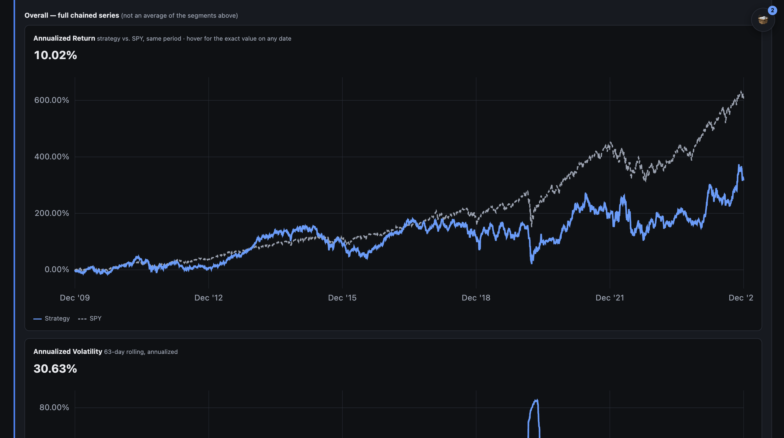
4
How the backtest actually works
MODULE 1 · FACTOR STRATEGY
One shared testing engine for every factor
1
You pick a start date, a holding period (3, 6, 12, or 24 months), and a basket size. At every rebalance the engine throws away the old shortlist and re-ranks completely fresh using only information available up to that date.
Tested the way you'd actually trade it
2
Because the ranking is redone at every rebalance using only past information, the result reflects a strategy you genuinely could have followed in real time — not a shortlist picked with the benefit of hindsight.
A full performance picture, not one number
The shared backtest engine: a real Value shortlist chained against SPY since 2009.
3
Every backtest reports total and annualized return, how bumpy the ride was, risk-adjusted return, and the worst peak-to-trough loss along the way — all charted against simply buying and holding the S&P 500, so you can judge whether the extra effort actually paid off.
Product Walkthrough · Non-Technical

Slide 5
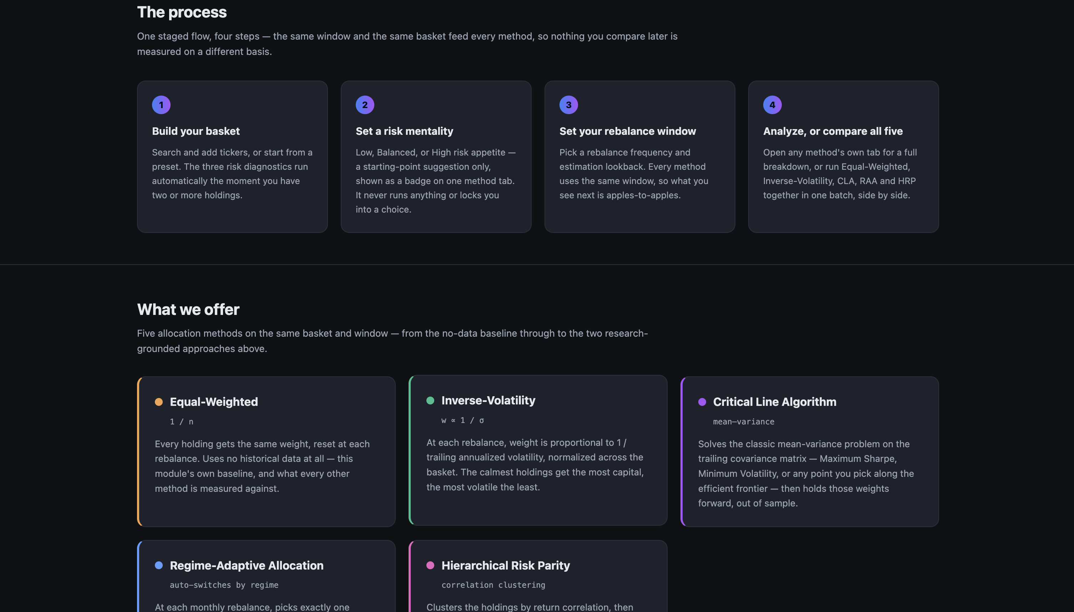
5
Portfolio & Risk Management
MODULE 2
Picking good stocks is only half of investing — how much money you put into each one is the other half. Splitting money evenly across everything ignores that some stocks swing much more than others, and that two “different” stocks might really just be moving in lockstep. This module checks your actual basket for exactly those problems, then gives you five ways to decide how much to put into each one.
Three automatic risk checks
1
The moment you have two or more holdings, the module checks how differently their prices actually swing, whether some are really just moving together in disguise (by correlation, sector, or market sensitivity), and whether their track records meaningfully differ.
A risk mentality you set, never forced
2
Choose low, balanced, or high as a starting-point suggestion for which allocation method might fit — you can always override it and pick any method you like.
Five allocation methods on tap
3
Equal-Weighted, Inverse-Volatility, Critical Line Algorithm, Regime-Adaptive Allocation, and Hierarchical Risk Parity — run one at a time, or all five together on the exact same basket and time window for an apples-to-apples comparison.
The four-step process, and the five allocation methods available.
One automatically adapts to the market
4
Regime-Adaptive Allocation switches its own rule every month depending on the platform's read of the current market environment — aggressive in calm, trending markets, defensive in a crisis, and equal-weighted the rest of the time.
Product Walkthrough · Non-Technical

Slide 6
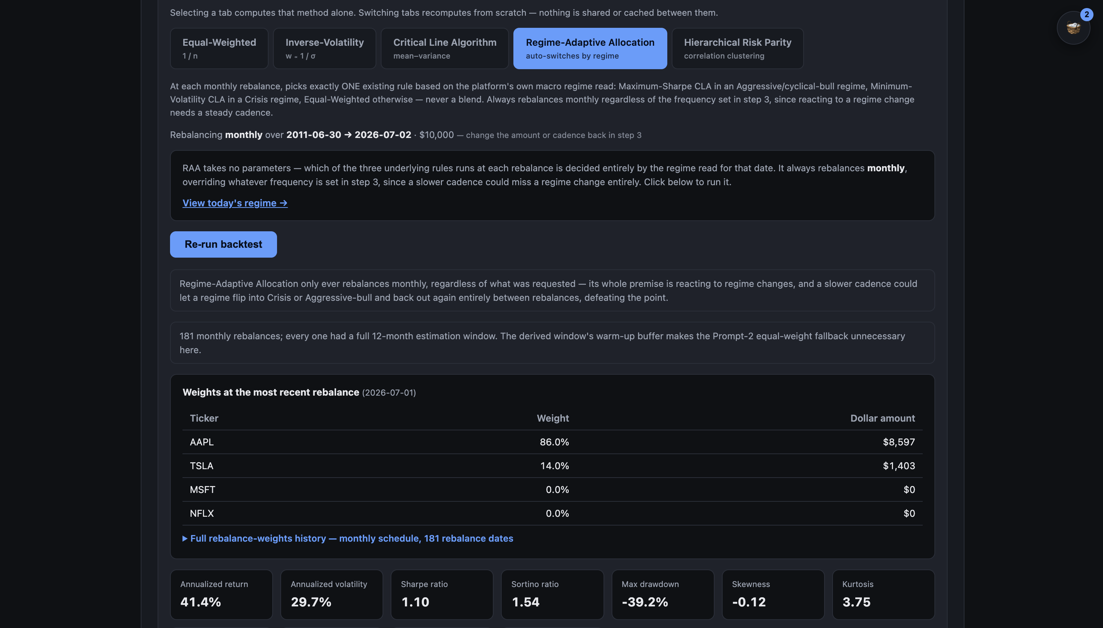
6
The five ways to split your money, explained
MODULE 2 · PORTFOLIO & RISK MANAGEMENT
Equal-Weighted & Inverse-Volatility
1
Equal-Weighted puts the same amount into everything and is the baseline every other method is measured against. Inverse-Volatility puts more money into the calmer holdings and less into the choppier ones.
Critical Line Algorithm
2
A math-based optimizer that solves for the best possible trade-off between risk and return across your basket, or specifically for the highest risk-adjusted return.
Regime-Adaptive Allocation & Hierarchical Risk Parity
3
Regime-Adaptive Allocation automatically swaps its underlying rule based on the current market environment. Hierarchical Risk Parity first groups similar-moving stocks together, then allocates, so one crowded cluster of correlated stocks doesn't quietly dominate the basket.
Regime-Adaptive Allocation running on a real four-stock basket.
Every method tested on the same footing
4
The exact same basket and estimation window feeds every method, so comparing them side by side is a fair, apples-to-apples comparison rather than five different setups.
Product Walkthrough · Non-Technical

Slide 7
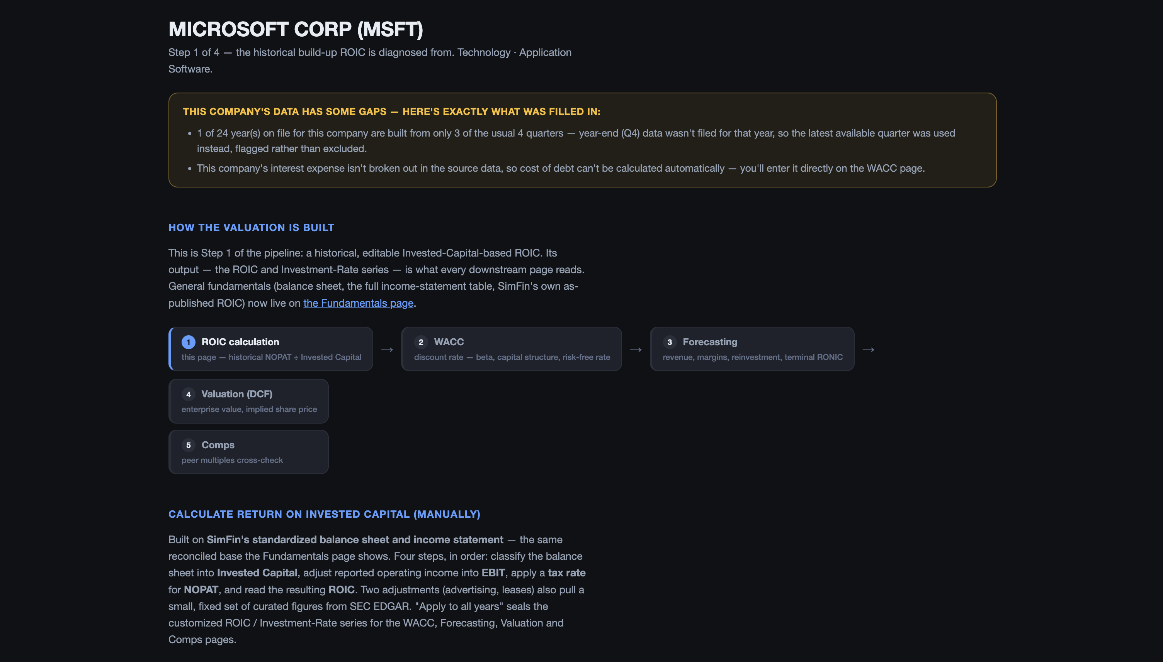
7
Long Term Valuation
MODULE 3
The price you see quoted is just what the market happens to agree on paying today — it can be too high, too low, or right. This module builds an independent estimate of what the business is actually worth, based on the cash it generates, using up to 24 years of the company's own real financial history.
A default path built from real history
1
Step 1 rebuilds the company's true return on invested capital. Step 2 works out the right discount rate for that specific company's risk. Steps 3 and 4 forecast cash flow forward and discount it back to today's dollars.
Nothing hidden about what's estimated
2
Every step flags exactly what data was missing or had to be estimated, rather than pretending the data is perfect or hiding the gap.
Change any assumption, see the value change
3
Growth rate, cost scaling, tax rate, dividend payout, and terminal growth are all yours to override — with five ready-made starting points (Bear, Base, Bull, Customized, and Market-Implied) so you don't have to build a scenario from scratch.
The five-step pipeline, each step feeding the next.
A market-based reality check, for every company
4
Step 5 finds real peer companies in the same industry and applies their actual trading multiples as a second opinion — run for every company valued, not just as a fallback for incomplete data.
Product Walkthrough · Non-Technical

Slide 8
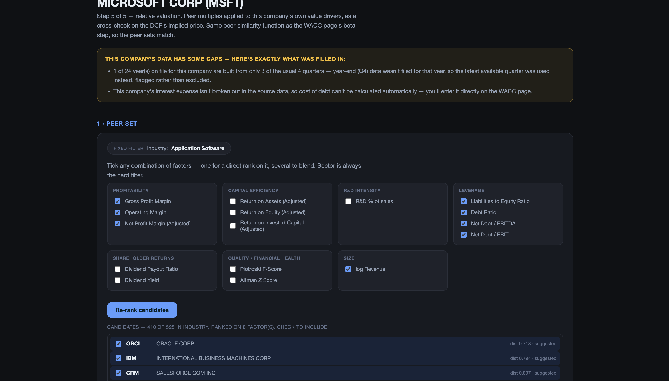
8
How the estimate is actually built
MODULE 3 · LONG TERM VALUATION
Comps: choosing what “similar” means
1
You choose which traits matter most — profitability, efficiency, debt levels, company size, and more — and the module ranks real candidates by how similar they actually are on those traits, not just by industry label alone.
Market-Implied: working backwards from the price
2
This scenario starts from today's actual stock price and works out what growth rate the market is already betting on — a direct way to see whether the market's assumption looks reasonable to you.
How much the tool covers today
A real peer search: similarity factors ticked, ranked candidates returned.
3
Most, if not all, of the companies on the platform have full data available. For the rare cases where one or two data points are genuinely missing, the module applies a proper fallback and clearly reports the irregularity, rather than quietly papering over it.
Product Walkthrough · Non-Technical

Slide 9
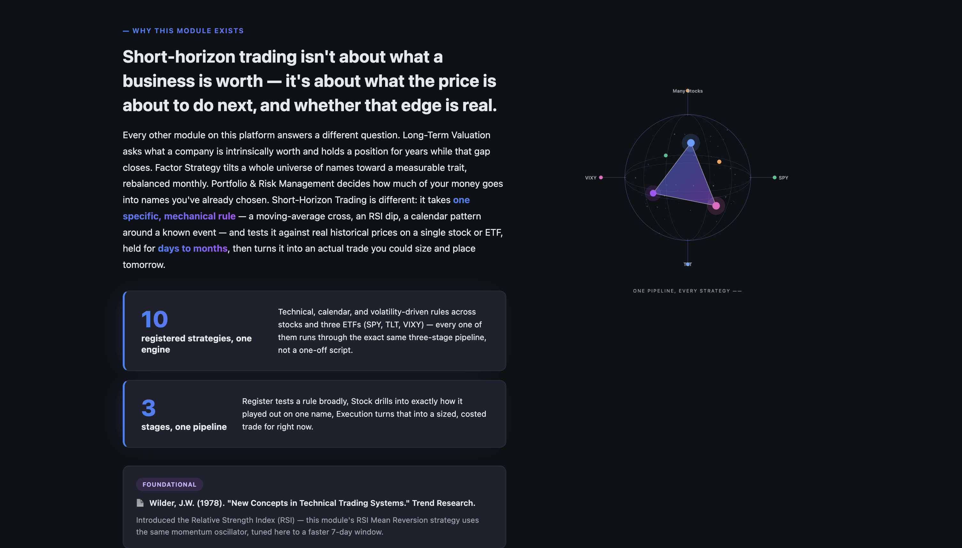
9
Short Horizon Trading
MODULE 4
This module answers a different question from the rest of the product: not what a company is worth, but what its price looks likely to do over the next few days to months. Ten specific, mechanical rules — never a vague “the model thinks it'll go up” — are each tested against real historical prices.
Ten strategies across stocks and three ETFs
1
RSI Mean Reversion, EMA Crossover, and TSMOM run across many stocks; a conditional VIXY hedge runs on SPY; three calendar-based rules run on TLT (long-term Treasuries); three more run on VIXY around options-expiration dates.
Register — does the rule work broadly?
2
Every strategy is tested across a wide, liquid universe of stocks and ranked by real backtest performance, not shown off with one cherry-picked example.
Stock — how did it play out on one name?
3
You get the full equity curve and a complete trade book for a single ticker — every entry, every exit, every gain and loss, nothing summarized away.
Ten registered strategies, one shared engine, each backtested on real historical prices.
Execution — what do I do right now?
4
The backtested rule becomes a real, sized trade for today, costed against your actual broker — with the exact position size, number of shares, and round-trip cost before you'd place it.
Product Walkthrough · Non-Technical

Slide 10
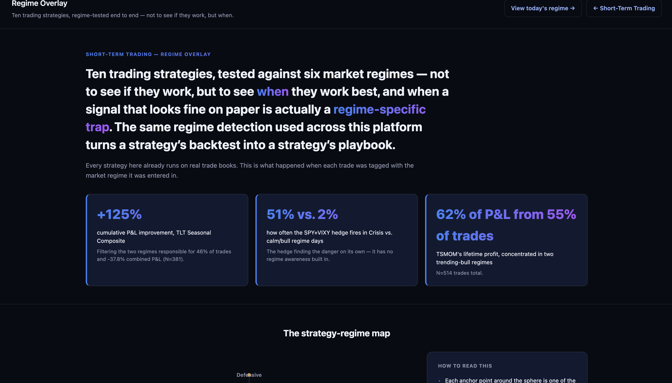
10
Does a strategy work the same in every market?
MODULE 4 · SHORT HORIZON TRADING
Every trade tagged by market regime
1
Every historical trade, across all ten strategies, is tagged with which of the platform's six market regimes was active the day it was entered — not to see if a strategy works, but to see when it works best.
Real brokers, real costs
2
The Execution page prices trades against ten real brokers — including Fidelity, Charles Schwab, Interactive Brokers, Robinhood, and E*TRADE — each with its own real commission structure, combined with a slippage estimate that scales with how liquid the stock actually is.
What the regime overlay actually shows
The regime overlay: every trade tagged by which market environment it fired in.
3
Some strategies only really work well in certain kinds of markets, and filtering out their weakest environments changes their overall picture meaningfully — the module surfaces exactly which regimes matter for each strategy, rather than leaving you to guess.
Product Walkthrough · Non-Technical

Slide 11
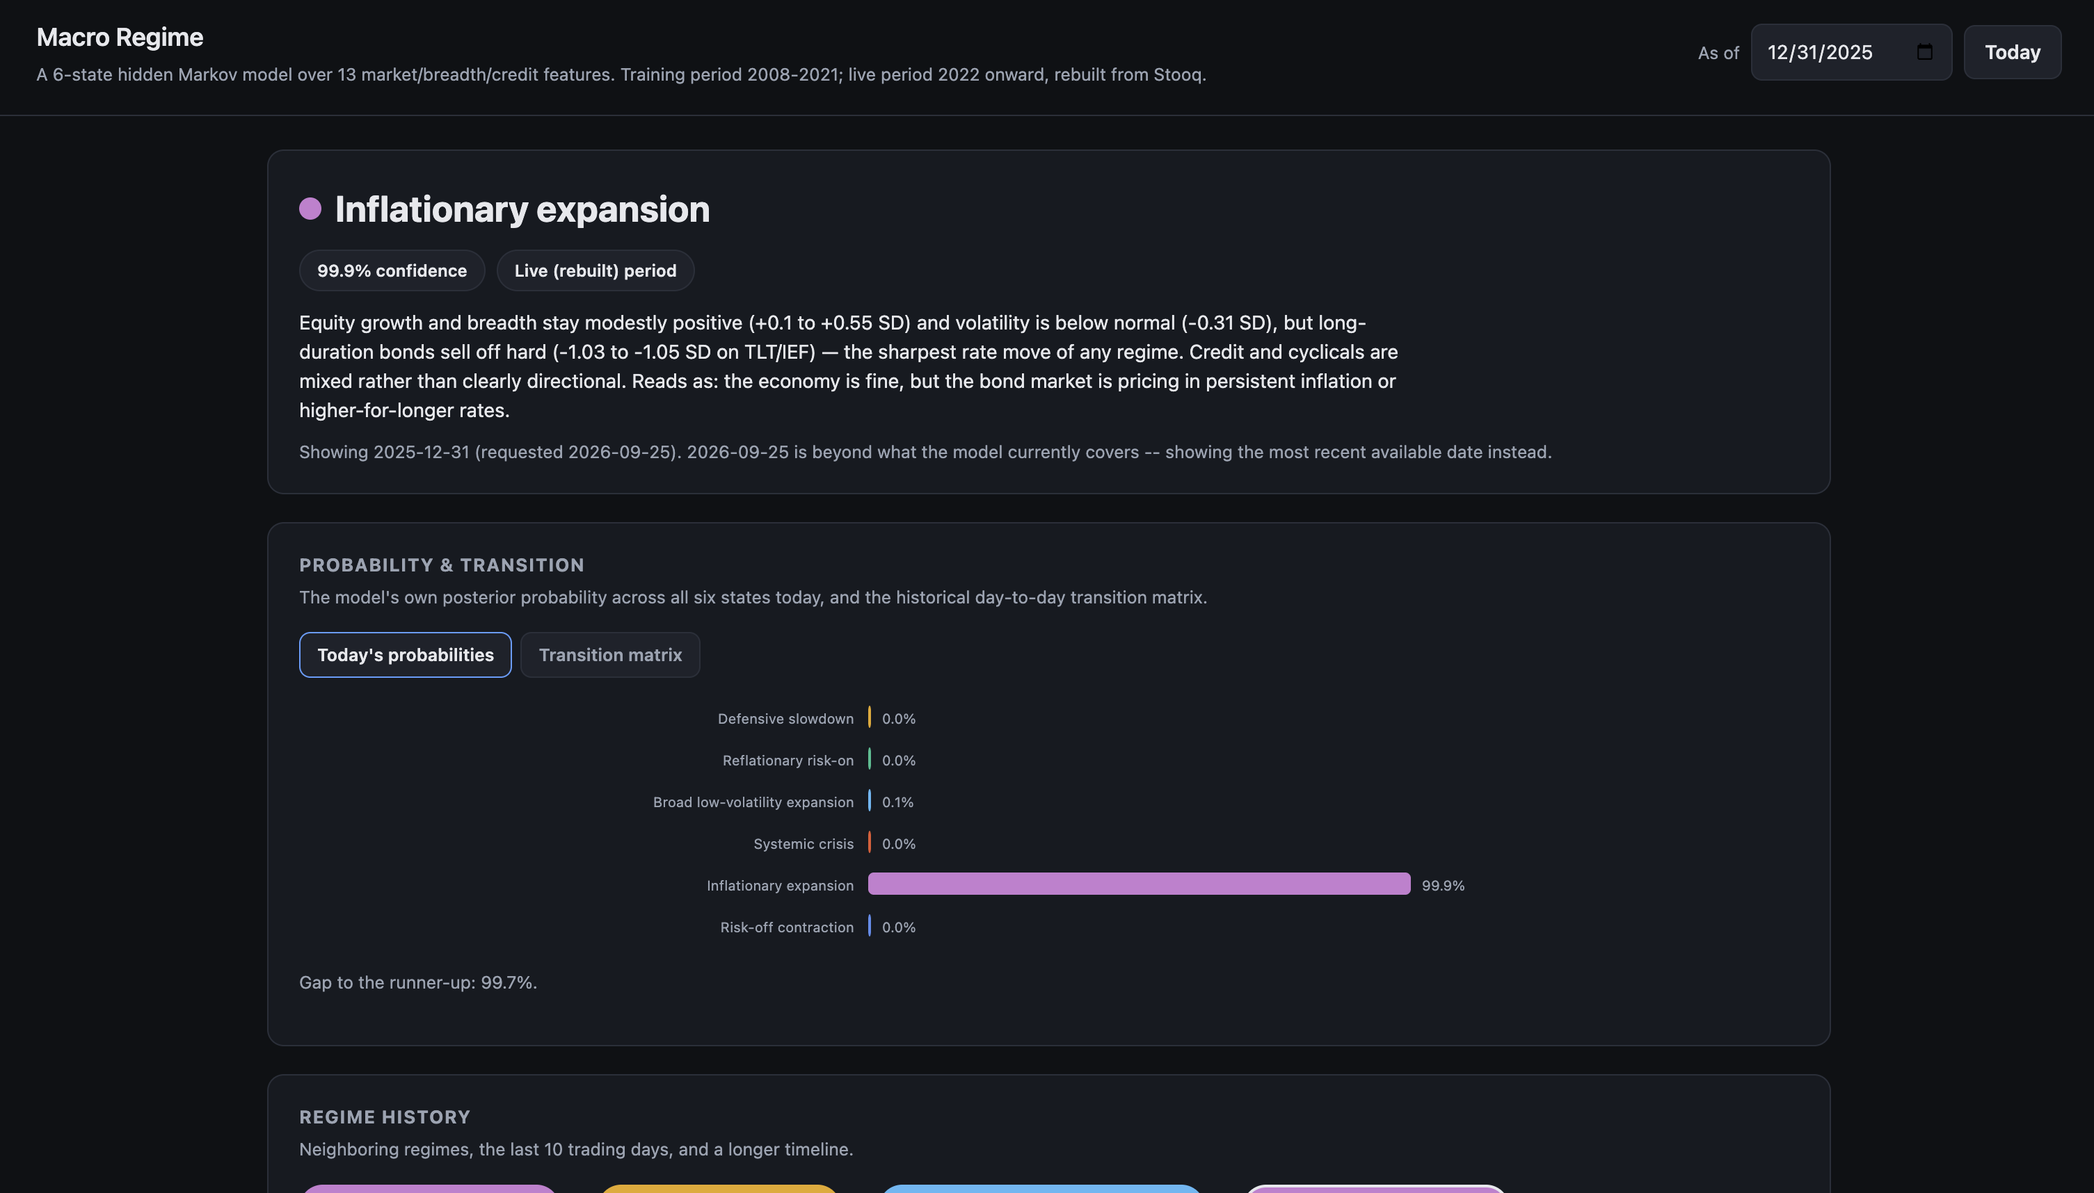
11
Macro Regime
MODULE 5
The other four modules each ask a question about one company or one strategy. This module asks the question underneath all of them: what kind of market is this, right now? It reads that environment every day, tells you plainly how confident it is, and quietly feeds that read into the other four modules.
Today's call, in plain terms
1
One of six named market regimes, alongside a confidence percentage and a plain-language explanation of exactly what's driving that call today — plus the gap between today's top call and the next most likely one.
What tends to happen next
2
A transition view shows the historical odds of moving from today's regime into each of the other five tomorrow — some regimes tend to stick around, others flip more easily.
Not a black box
3
Thirteen real market signals feed the read, grouped into plain categories — how broadly stocks are participating, what bonds and rates are doing, credit appetite, and cyclical versus defensive behavior — shown side by side, not hidden behind one confidence number.
Today's live call: one of six states, with confidence and the driver behind it.
Quietly feeds three other modules
4
Short Horizon Trading tags every trade with the regime it fired in. Portfolio Management's Regime-Adaptive Allocation switches its rule every month based on this exact read. Factor Strategy's regime-tested factors show how they've performed within each regime historically.
Product Walkthrough · Non-Technical

Slide 12
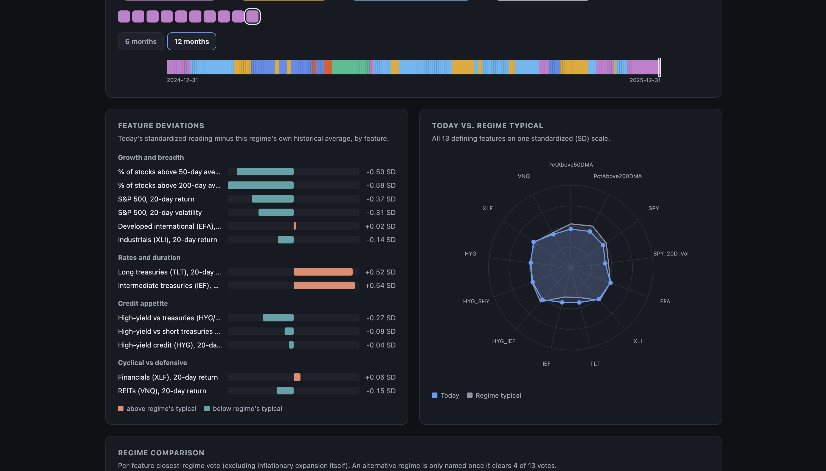
12
How the read is actually made
MODULE 5 · MACRO REGIME
A regime history you can see
1
A history strip shows the last several months of daily calls at a glance, plus exactly how many days in a row the current regime has held.
Built to be checked, not trusted blindly
2
For any day, you can see exactly how far today's reading sits from that regime's own historical normal on every one of the thirteen signals — so the call is something you can sanity-check yourself.
One honest limit
Exactly which of 13 signals are driving the call — not a black box.
3
Long Term Valuation does not yet read from this engine — stated plainly here rather than glossed over.
Product Walkthrough · Non-Technical

Slide 13
CLOSING
Five questions, five modules, real numbers behind every one
Which traits predict returns, how much to put into each stock, what a business is really worth, what a price is about to do next, and what kind of market this actually is right now — every feature shown here is something you can go run yourself in the product today.
For the full detail behind all of this, see Product_Walkthrough_Non_Technical_New.pdf
Prepared by Vignesh Swamynathan

